Slide 1

IoT for insurance:
A case for
Complex event processing
Markus Müller
email:markus_mueller@de.ibm.com
1/18/17

Slide 2
Motivation

Slide 3















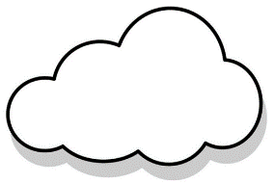


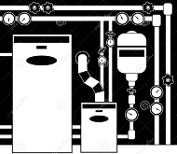



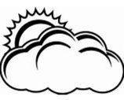




Insurance Industry Transformation to Proactive Protection & Claims Avoidance
Carriers are transforming their historic risk assessment models by proactively mitigating risk through real time alerts and analytics
Protected
Lifestyle & Business
Risks
Assets
Finances
Protected
Wellness / Workers
Protected
Cars / Fleet
Safety
Health
Contextual
Insights
Driver Profiles
Telematics
Mapping
Analysis
Real-time
Monitoring
Alerts
Protected
Home & Buildings
Protected
Assets & Equipment
Homes
Ships
Factories
Warehouses
Construction Sites
Commercial Office
Protected Environment
Predictive Maintenance
Authorized Access
Location
Weather
Construction
Crime
Notes:
Einteilung in indivuelle Risiken für natürliche Personen
Und institutionelle Risiken für juristische Personen
(mix bei worker safety)

Slide 4

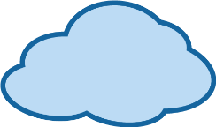

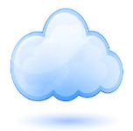
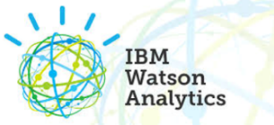








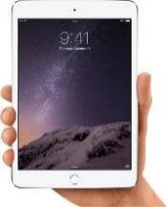
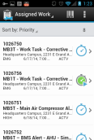

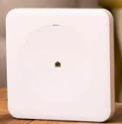
IBM IoT for Insurance – How it works
2
Data streams into Watson IoT Platform providing Insurers data
Connected Auto
IoT Device & Equipment Vendors
1
Watson IoT
Platform
Wearables/ Sensors
Insurance Holder registers Sensors / Hub/Wearables via IoT
3
Smart Home Hub
4
Advanced Analytics and Shields of protection produce Actions such as Driver Behavior, Leak Detection, Worker Fatigue
Consumer and Claims Adjusters can manage actions, perform device command and control functions
Notes:
1 insurance holder ist der Hausbesitzer im Falle von Smarter Home, der Bauer für die “Kuh”sensoren, die Fimenleitung für worker safetly
1→ 2 hier kommt Cloud-to-Cloud und der Hub/Gateway Anbieter in Spiel

Slide 5
Insurance shield example
“Door opens at night”
Evaluating this rather convoluted shield gives rise to Complex Event Processing:
Requirement:
Stateful processing
Sliding windows
Other shields like “heart rate monitoring” make use of tumbling windows.
See also here
https://i.stack.imgur.com/mm06A.jpg
For windowing in data stream processing
Notes:
Shields can be as simple as there is a water intrusion where water should not be so contact a neighbor or shut off the water – to correlating outside temperature, body temperature, type of work, looking at overall speed of motion for past 5 hours to determine someone has fatigue and could be at risk of a fall, causing potential injuries. The key of the shields are to help detect issues before they ever occur.
Worker safety Beispiel. Hier ein Beispiel wie man über die Zeit ein safelet per ML “trainieren” kann.
Aggregation kann sowohl zeitlich, als auch über mehrere Sensoren stattfinden.

Slide 6



Insurance shields examples in more details
Hazard
Detection
Check
conditions
Expedite
Response/Alerts
Simple Shields: Rule base , Multi sensor , Time window
Detect “Water leak” hazard
if water sensor == wet for last 4 minutes && water valve == close
Check:
(location == @home)
&& (08:00 < now < 18:30)
send push notification to
Insured.phone-number
Detect “overexertion” hazard
if last 20 reading of heart-rate > 80 && Heat index > 80
Check:
(location == @work)
&& (23:00 < now < 05:00)
send push notification to
Employee.supervisor.phone-number
Complex Shield: ML , Aggregations, Personalization
Detect “Anomaly Water leak” risk
2 or water sensor == wet for last 30 sec && water valve == open && current temp < avg temp + 20 && weather == dry
Check:
(location != @home) ||
(22:00 > now) || (now < 05:30)
send push notification to
Insured.phone-number
send SMS to
available plumber.phone-number
Detect “overexertion” hazard
if last 20 readings (heart-rate) > Avg Rest HR && normal heat index for location> 80
Check:
(location == @work)
&& (23:00 < now < 05:00)
send push notification to
Employee.supervisor.phone-number
Cognitive Shield : Cognitive Diagnostics , Pattern Recognition (Activity, Gestures) , Shields Personalization , Offline Learning
Prevent “Heat Stress” hazard
If user spent last 30 minutes at heat index > 85 && and user situation is “intensive physical working” , and body temp > avg body temp for “intensive physical working” activity || body temp > body temp at beginning of shift + 3
&& User specify “dry throats” and drowsiness && system didn’t capture water intake gestures
Notes:
Shields can be as simple as there is a water intrusion where water should not be so contact a neighbor or shut off the water – to correlating outside temperature, body temperature, type of work, looking at overall speed of motion for past 5 hours to determine someone has fatigue and could be at risk of a fall, causing potential injuries. The key of the shields are to help detect issues before they ever occur.
Worker safety Beispiel. Hier ein Beispiel wie man über die Zeit ein safelet per ML “trainieren” kann.
Aggregation kann sowohl zeitlich, als auch über mehrere Sensoren stattfinden.

Slide 7
Technical background

Slide 8
Complex event processing in a nutshell
Events
exhibit the following characteristics. They
Are Immutable
Have strong temporal constraints
Have a managed lifecycle (become “stale” after some time) and thus as subject to a sliding window of ‘validity’).
In the IOT case events have some ‘sparseness’ traits, so
There is a high volume of events.
Patterns are more important than invidual events.
Event Processing
is a method of tracking and analyzing (processing) streams of information (data) about things that happen (events),[1] and deriving a conclusion from them.
Complex Event Processing
or CEP, is event processing that combines data from multiple sources to infer events or patterns that suggest more complicated circumstances. The goal of complex event processing is to identify meaningful events (such as opportunities or threats) and respond to them as quickly as possible.
Traits/functional requirements
Allow detection, correlation, aggregation and composition of events.
Support processing of Streams of events.
Support temporal constraints in order to model the temporal relationships between events.
Support sliding windows of interesting events.
Support a properly scoped unified clock - in the case mentioned in the deck the proper scope would be all sensors in the belderly person's apartment.
Support the required volumes of events for CEP use cases.
Support MQTT for event input into the engine.
For background see wikipedia.org

Slide 9
Requirements for complex event processing
“At least once” guarantee
No IoT event must get lost before being processed. IoT events must be retained/buffered until handled otherwise we could lose events, resp. do not sent out actions
Note that this implies fault tolerance, i.e. restartability while preserving its internal state.
Partial ordering guarantee
Events for a particular group of devices (for example grouped by ownership) must be delivered and processed in order.
→ See elderly care example.
“Exactly once” guarantee
No action must be triggered twice.
Scalability
CEP must scale with number of users and event rate.
Latency
Actions must be triggered in less than 10 secs.
This ballpark figure reflects the near-realtime characteristics tempered with the latency of external components (e.g. network). Note that latency guarantees imply availability.
Supports modular programming model
Adding/Modifying a shield (specific complex event evaluation) should not affect other shields (Modular development, test and deployment)
Modification without outage
Adding/Modifying a shield should be possible without stopping the execution of this shield.
Rule Editor
Shield development & deployment should be easy.
Low Dev/Test effort
Shield engine development effort should be as low as possible
Low Total cost of ownership
Operations (monitoring & runbooks) and maintenance costs should be as low as possible
Automated instance deployment
This either means a multi-tenant solution where instance creation doesn't affect deployment or we need a fully automated true deployment. The former requires tenant isolation, the latter either a bluemix service or well designed setup 'scripts'. Upgrade without downtime is subsumed here.
Cost
Costs for components used to deploy the shield engine should be as low as possible.
For background and terminology
see https://dzone.com/articles/kafka-clients-at-most-once-at-least-once-exactly-o

Slide 10
Fault tolerance – pattern matching state engine data
Considerations:
Saving state vs. periodic checkpointing vs. saving event offsets
Saving state requires a write operation after applying operators in the pattern matching, so we get many small write operations.
Saving event offset of the event when the state engine was in initial state requires the event source to maintain persistency and runs the risk of duplicate actions
Periodic Checkpointing covers the middle ground
What datamodel is the best fit ?
Saving offsets requires minimal amount of data, basically a triple of shield, user and queue offset to the last terminal event that causes a transition of the state engine to initial state.
Saving state or checkpointing results in unstructured data best suited for flat files or a NoSQL database.
current
state
saving pattern matching
engine’s state
Notes:
(1) Sensoren im Haus liefern die Daten, werden von Versicherer geliefert
(2) Hausbesitzer registriert sich – entweder per Cloud-to-Cloud oder direkt.
(3) IoT4I gleicht Vertragsnummer etc. ab
(4) und Hausbesitzer delegiert Zugriff auf Cloud-Repräsentation von Sensoren/Gateways an IoT4I (OAuth)
(5) Sensordaten werden mit 3rd party Daten angereichert (weather.com) und auf unerwünschte Abweichungen hin gecheckt
(6) Im Falle einen Problems, sende Alarm zu Kunden und Versicherer.
(7) Wird aus dem Problem ein Schadensfall, leite ‘automatic’ claiming ein.

Slide 11
Complex Event Processing in an IoT context/architecture
Complex Event Processing typically needs to be executed near real-time as close as possible to the event sources, so in a Lambda architecture it takes place here
Notes:
(1) Sensoren im Haus liefern die Daten, werden von Versicherer geliefert
(2) Hausbesitzer registriert sich – entweder per Cloud-to-Cloud oder direkt.
(3) IoT4I gleicht Vertragsnummer etc. ab
(4) und Hausbesitzer delegiert Zugriff auf Cloud-Repräsentation von Sensoren/Gateways an IoT4I (OAuth)
(5) Sensordaten werden mit 3rd party Daten angereichert (weather.com) und auf unerwünschte Abweichungen hin gecheckt
(6) Im Falle einen Problems, sende Alarm zu Kunden und Versicherer.
(7) Wird aus dem Problem ein Schadensfall, leite ‘automatic’ claiming ein.

Slide 12
Selecting candidates

Slide 13
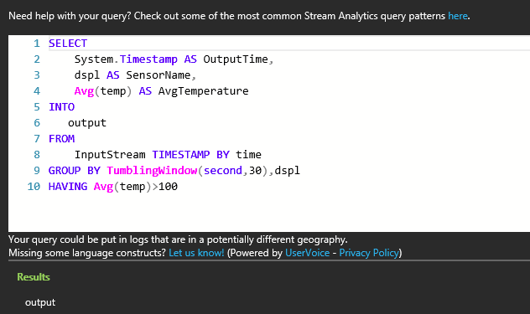
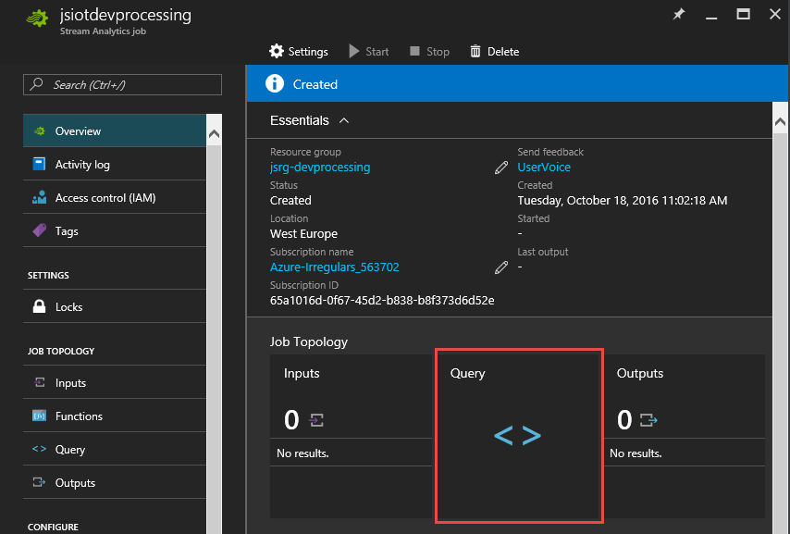
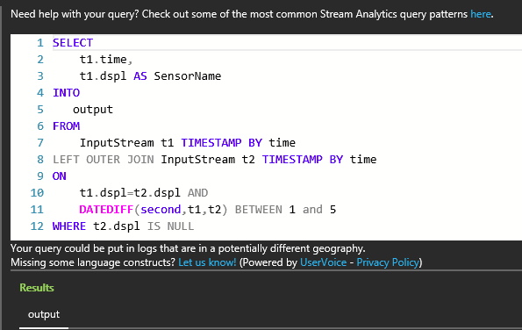
Setting the stage – Azure Stream Analytics
Query: Alert to trigger a business workflow
IoT Events
Tumbling Window
Query: Detect absence of events
Compare filtered with non-filtered output (based on timestamps)
Compare filtered with non-filtered output
Compare filtered with non-filtered output
https://docs.microsoft.com/en-us/azure/stream-analytics/stream-analytics-build-an-iot-solution-using-stream-analytics

Slide 14
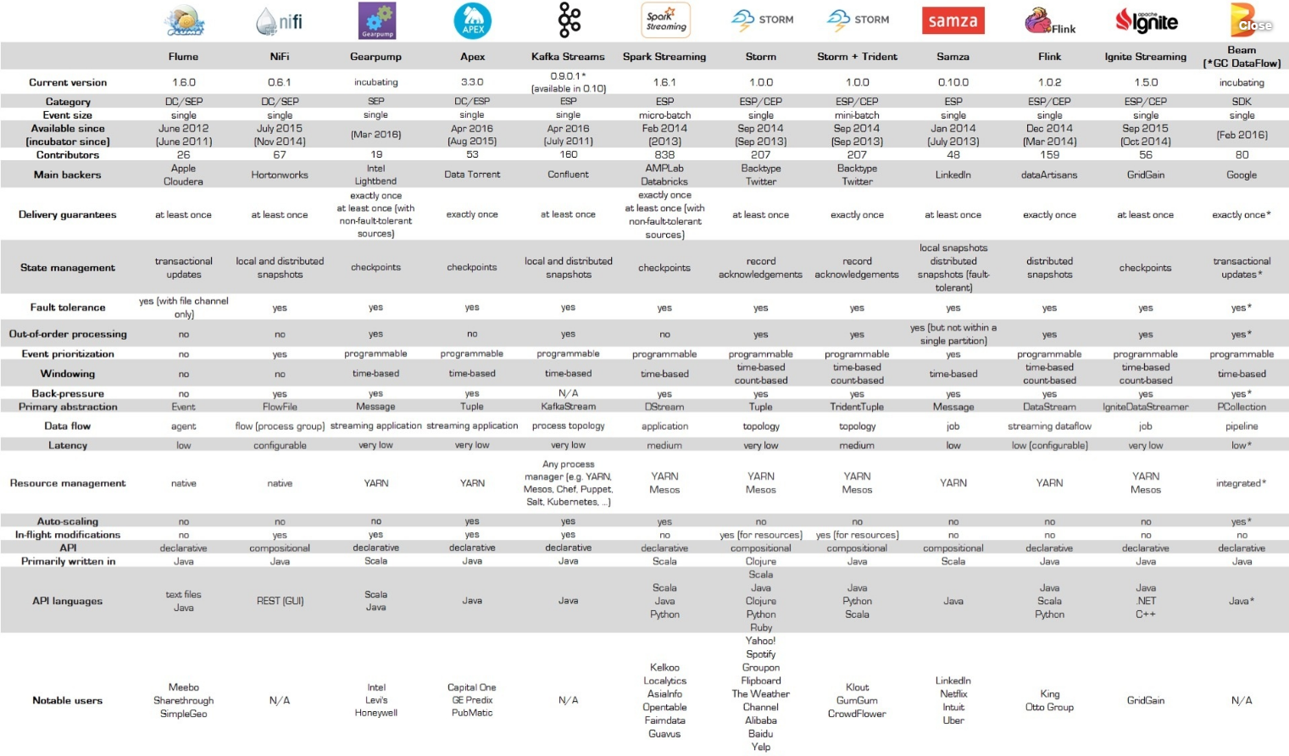
Open Source frameworks for handling stream data
Taken from Ian Hellström, https://databaseline.wordpress.com/2016/03/12/an-overview-of-apache-streaming-technologies/

Slide 15





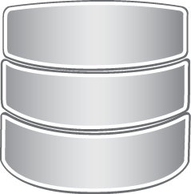
Approach #1: Kafka shield engine
IoT platform
This approach is similar to Apache Samza, but makes use of Bluemix as job execution layer.
In case of a worker failure, restart,
retrieve last offset of “its” partition (water mark)
Then get last date from the last committed offset (events + intermediate results)
MQTT to
Kafka bridge
(part of
IBM message hub)
Consumer Group #2
Topic #2
Consumer Group #1
Action Engine
Topic #1
Worker #1
Zookeeper
Partition #1
Message Hub
(Kafka)
Partition #2
Worker #2
Partition #n
Worker #m
Worker starts up
worker receives new message from the assigned partition
For onOnceData messages (“unfamiliar” partition) it retrieves the water mark and replays events from there (intermediate data is treated like an event)
For any hazard the new offset is stored as new water mark for this topic
Water Mark Topic
Association of worker and partition is maintained by Kafka after worker registration
Partial event order is preserved
Event replay offset needed for worker recovery
Notes:
(1) Sensoren im Haus liefern die Daten, werden von Versicherer geliefert
(2) Hausbesitzer registriert sich – entweder per Cloud-to-Cloud oder direkt.
(3) IoT4I gleicht Vertragsnummer etc. ab
(4) und Hausbesitzer delegiert Zugriff auf Cloud-Repräsentation von Sensoren/Gateways an IoT4I (OAuth)
(5) Sensordaten werden mit 3rd party Daten angereichert (weather.com) und auf unerwünschte Abweichungen hin gecheckt
(6) Im Falle einen Problems, sende Alarm zu Kunden und Versicherer.
(7) Wird aus dem Problem ein Schadensfall, leite ‘automatic’ claiming ein.

Slide 16


Approach #2: OpenWhisk shield dispatcher on Kafka
IoT platform
In case of a shield snippet failure, kafka will present message again, intermediate states (past events, time windows) are retrieved from Redis.
This approach is suitable for handling actions as well.
MQTT to
Kafka bridge
(part of
IBM message hub)
OpenWhisk
Action Engine
Shield snippet #1
Zookeeper
Partition #1
IBM Message hub
(Kafka)
Kafka consumers
Kafka triggers
Shield snippet #2
Partition #2
Kafka consumers
Partition #n
Shield snippet #K
This approach violates the partial event ordering guarantee
Notes:
(1) Sensoren im Haus liefern die Daten, werden von Versicherer geliefert
(2) Hausbesitzer registriert sich – entweder per Cloud-to-Cloud oder direkt.
(3) IoT4I gleicht Vertragsnummer etc. ab
(4) und Hausbesitzer delegiert Zugriff auf Cloud-Repräsentation von Sensoren/Gateways an IoT4I (OAuth)
(5) Sensordaten werden mit 3rd party Daten angereichert (weather.com) und auf unerwünschte Abweichungen hin gecheckt
(6) Im Falle einen Problems, sende Alarm zu Kunden und Versicherer.
(7) Wird aus dem Problem ein Schadensfall, leite ‘automatic’ claiming ein.

Slide 17
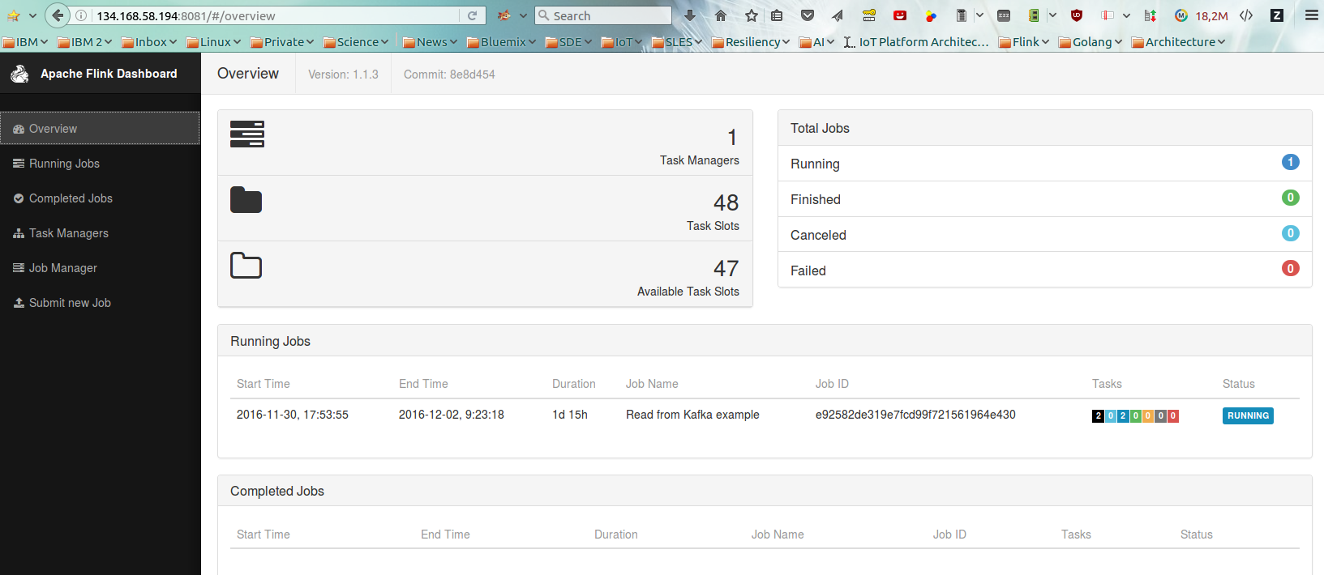

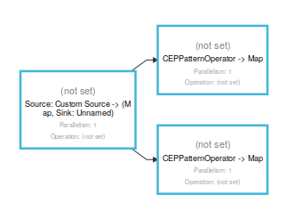
Approach #3: Apache Flink with Kafka connector
MQTT to Kafka bridge
(part of IBM message hub)
Zookeeper
IoT platform
Message Hub
(Kafka)
IoT platform
Flink
Jobmanager
Consume and analyze
event stream from Kafka topic
Rely on YARN for restart and
on HDFS for Checkpointing
Flink Taskmanager(s)
Flink MQTT Consumer Task
Scaling considerations:
Flink job optimizer computes job parallelization plan during deployment, but requires restart to rescale later on:
http://de.slideshare.net/tillrohrmann/dynamic-scaling-how-apache-flink-adapts-to-changing-workloads
MQTT Backpressure considerations:
Flink checkpoints every 5 secs by default, IoT4I expects < 120 evts/sec, with a dedicated IoT platform MQTT broker we’re well below the limit of 5000 retained messages (Watson IoTP)
See the following NewRelic presentation for a real life data aggregation show case
http://berlin.flink-forward.org/wp-content/uploads/2016/07/Ron-Crocker-Evaluating-Streaming-Framework-Performance-for-a-Large-Scale-Aggregation-Pipeline.pdf
Notes:
(1) Sensoren im Haus liefern die Daten, werden von Versicherer geliefert
(2) Hausbesitzer registriert sich – entweder per Cloud-to-Cloud oder direkt.
(3) IoT4I gleicht Vertragsnummer etc. ab
(4) und Hausbesitzer delegiert Zugriff auf Cloud-Repräsentation von Sensoren/Gateways an IoT4I (OAuth)
(5) Sensordaten werden mit 3rd party Daten angereichert (weather.com) und auf unerwünschte Abweichungen hin gecheckt
(6) Im Falle einen Problems, sende Alarm zu Kunden und Versicherer.
(7) Wird aus dem Problem ein Schadensfall, leite ‘automatic’ claiming ein.

Slide 18
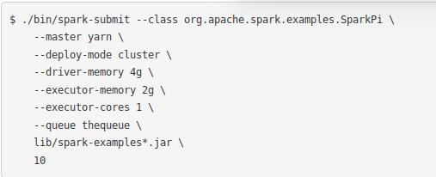

Approach #4: Apache Spark Streaming with Kafka connector
MQTT to
Kafka bridge
(part of
IBM message hub)
Spark Driver Program
Rely on YARN for restart and
on HDFS for Checkpointing
Zookeeper
Spark Context
Message Hub
(Kafka)
IoT platform
Spark Task Manager
Spark Task
Backpressure considerations:
Spark makes use of microbatching over D(istributed)Streams, an ensemble of Resilient Distributed Datasets that can be checkpointed; period depends on the DStream’s granularity (default interval 10sec; checkpointing is a multiple of that, so >= 10 secs). IoT4I expects < 120 evts/sec, with a dedicated IoT platform MQTT broker + Kafka Hub we’re well below the event rate that can be consumed by a regular Spark Streaming Task.
BTW, the current MQTT Spark consumer (Bahir) does not support back pressure, so Kafka is required here
For background see
http://spark.apache.org/docs/latest/streaming-programming-guide.htm
http://spark.apache.org/docs/latest/running-on-yarn.html
Notes:
(1) Sensoren im Haus liefern die Daten, werden von Versicherer geliefert
(2) Hausbesitzer registriert sich – entweder per Cloud-to-Cloud oder direkt.
(3) IoT4I gleicht Vertragsnummer etc. ab
(4) und Hausbesitzer delegiert Zugriff auf Cloud-Repräsentation von Sensoren/Gateways an IoT4I (OAuth)
(5) Sensordaten werden mit 3rd party Daten angereichert (weather.com) und auf unerwünschte Abweichungen hin gecheckt
(6) Im Falle einen Problems, sende Alarm zu Kunden und Versicherer.
(7) Wird aus dem Problem ein Schadensfall, leite ‘automatic’ claiming ein.

Slide 19
Approach #5: Agent framework based shield dispatcher on MQTT
Considerations
Rules determine which shields have to be called; Rules engine/Rule set can be set per tenant.
Agents take work based on deviceId groups, thus ensuring partial event order. Scaling can be achieved by adding agents,.
Checkpointing must be implemented separately.
Action engine could be rewritten in the Agent Framework as agents
Note: this approach is not well understood yet
IoT platform
Agent Controller VM
Rule
Rule
Rule Engine-A
Rule Engine-B
Rule Engine Proxy
Action Engine
Rule Manager
Agents: fall detect
Action Controller
Agents: heartbeat
Agents: movement
Messaging
Interface
Agents smoke
Agents: waterleak
Shield Agents
The agent framework is classified as special asset, so neither code, nor a binary will be made available to the IoT4I dev team. Hence we do not pursue this option
External SQL DB
Notes:
(1) Sensoren im Haus liefern die Daten, werden von Versicherer geliefert
(2) Hausbesitzer registriert sich – entweder per Cloud-to-Cloud oder direkt.
(3) IoT4I gleicht Vertragsnummer etc. ab
(4) und Hausbesitzer delegiert Zugriff auf Cloud-Repräsentation von Sensoren/Gateways an IoT4I (OAuth)
(5) Sensordaten werden mit 3rd party Daten angereichert (weather.com) und auf unerwünschte Abweichungen hin gecheckt
(6) Im Falle einen Problems, sende Alarm zu Kunden und Versicherer.
(7) Wird aus dem Problem ein Schadensfall, leite ‘automatic’ claiming ein.

Slide 20
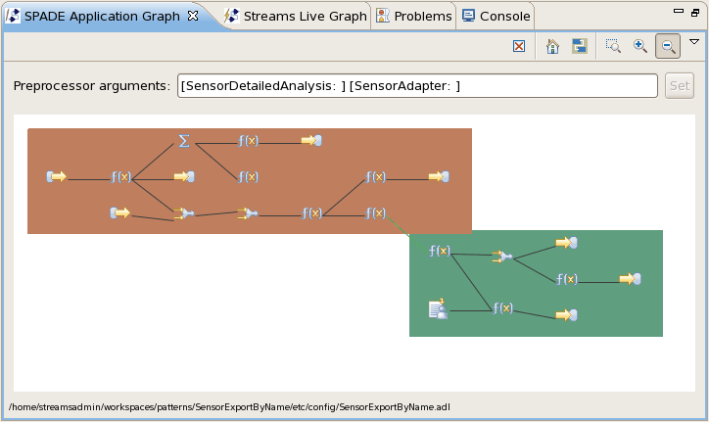
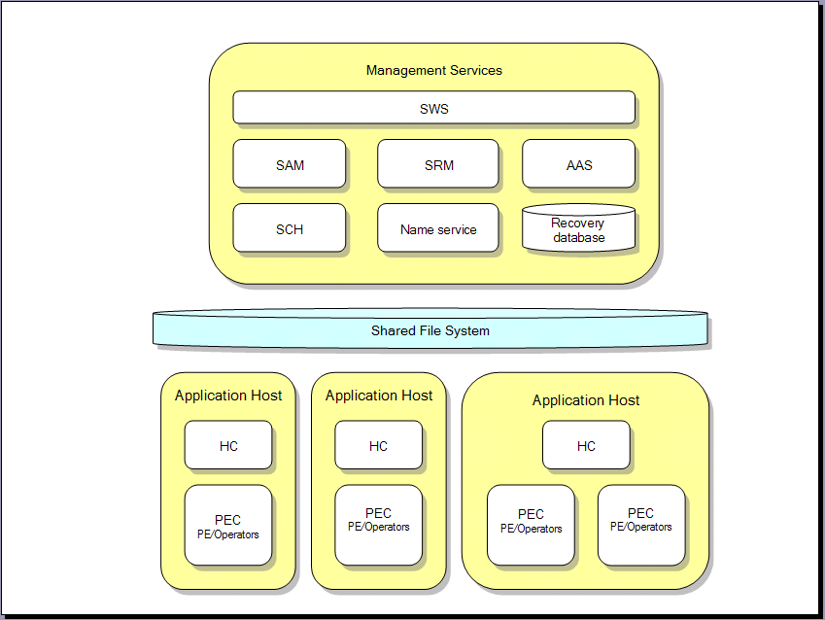
Approach #6: IBM Streams
IoT platform
Action Engine
MQTT Source Operator
com.ibm.streams.messaging.mqtt
External SQL DB
Notes:
(1) Sensoren im Haus liefern die Daten, werden von Versicherer geliefert
(2) Hausbesitzer registriert sich – entweder per Cloud-to-Cloud oder direkt.
(3) IoT4I gleicht Vertragsnummer etc. ab
(4) und Hausbesitzer delegiert Zugriff auf Cloud-Repräsentation von Sensoren/Gateways an IoT4I (OAuth)
(5) Sensordaten werden mit 3rd party Daten angereichert (weather.com) und auf unerwünschte Abweichungen hin gecheckt
(6) Im Falle einen Problems, sende Alarm zu Kunden und Versicherer.
(7) Wird aus dem Problem ein Schadensfall, leite ‘automatic’ claiming ein.

Slide 21
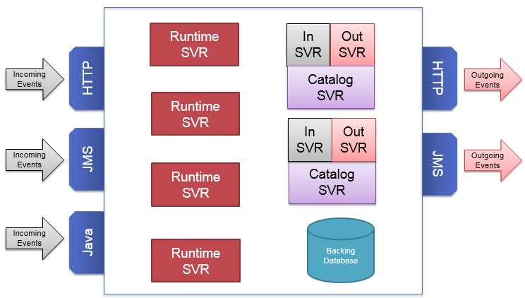
Approach #7: ODM Decision Server Insights
IoT platform
MQTT bridge
Action Engine
External SQL DB
See also
https://hub.jazz.net/project/dselman/InternetOfInsight/overview
Notes:
(1) Sensoren im Haus liefern die Daten, werden von Versicherer geliefert
(2) Hausbesitzer registriert sich – entweder per Cloud-to-Cloud oder direkt.
(3) IoT4I gleicht Vertragsnummer etc. ab
(4) und Hausbesitzer delegiert Zugriff auf Cloud-Repräsentation von Sensoren/Gateways an IoT4I (OAuth)
(5) Sensordaten werden mit 3rd party Daten angereichert (weather.com) und auf unerwünschte Abweichungen hin gecheckt
(6) Im Falle einen Problems, sende Alarm zu Kunden und Versicherer.
(7) Wird aus dem Problem ein Schadensfall, leite ‘automatic’ claiming ein.

Slide 22
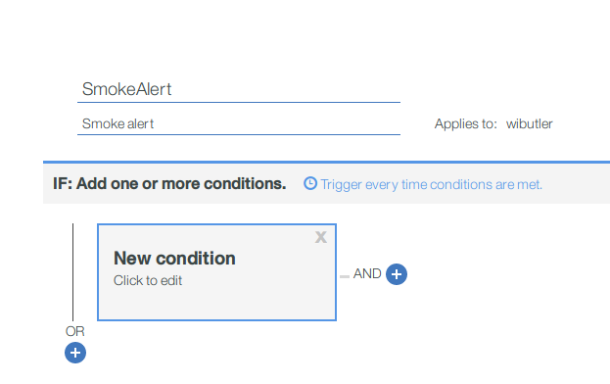

Approach #8: Real Time Insights
User:
Submit ruleset
(translated into a
stream of meta data)
DevOps:
Submit Kafka
Consumer Jobs
MQTT to
Kafka bridge
(part of
IBM message hub)
Spark Driver Program
Rely on YARN for restart and
on HDFS for Checkpointing
Zookeeper
Spark Context
Message Hub
(Kafka)
IoT platform
Consume and analyze
Kafka topic event stream
Spark Task Manager
Spark Task
RTI is built on Spark Streaming
Payload is processed according to Metadata. This is possible due to
For background see
http://spark.apache.org/docs/latest/streaming-programming-guide.htm
http://spark.apache.org/docs/latest/running-on-yarn.html
Notes:
(1) Sensoren im Haus liefern die Daten, werden von Versicherer geliefert
(2) Hausbesitzer registriert sich – entweder per Cloud-to-Cloud oder direkt.
(3) IoT4I gleicht Vertragsnummer etc. ab
(4) und Hausbesitzer delegiert Zugriff auf Cloud-Repräsentation von Sensoren/Gateways an IoT4I (OAuth)
(5) Sensordaten werden mit 3rd party Daten angereichert (weather.com) und auf unerwünschte Abweichungen hin gecheckt
(6) Im Falle einen Problems, sende Alarm zu Kunden und Versicherer.
(7) Wird aus dem Problem ein Schadensfall, leite ‘automatic’ claiming ein.

Slide 23
Decision Matrix “Must Have requirements”
 | “At least once” Fault tolerance, Back pressure | Partial ordering guarantee | “Exactly once” | Scalability (without affecting runtime) | Latency | Functional elements Stateful operators + Windows
Kafka shield engine | Yes | Yes | Maybe | By adding partitions and workers (online) | Low | No stateful sliding or tumbling windows
OpenWhisk shield dispatcher on Kafka | Yes | No | No | By adding partitions (online) | Medium due to OpenWhisk | No stateful sliding or tumbling windows
Apache Flink with Kafka connector | Yes | Yesb | Yes | Redeploy Flink CEP Program with higher parallelization (red-black) | Low | Yes
Spark Streaming on Kafka | Yes | Yes | No | Redeploy Spark Streaming program (red-black) | Medium due to micro-batching | Limited There are unmaintained packages available
Agent framework shield dispatcher on MQTT | Yes | Yes | No | Yes | Low (according to their dev team) | No stateful sliding or tumbling windows, no operators
IBM streams | Yes | Yes | Yes | Yes (online ?) | Low | Yes
ODM Decision Server Insights | Yes | Yes | Not known | Yes | Not known | Yes
Real Time Insight | Yes | Yes | No | Yes | See Spark Streaming | No stateful sliding or tumbling windows
Work in progress
Notes:
Why not streams – costs, not available on all locations (Dallas, London, Sydney) when I started evaluation
Partners look for Open Source and more specifically Flink
IBM Streams: €2.82 EUR/Node hour per tenant instance → 24000 EUR/year

Slide 24
Decision Matrix “Should Have requirements”
 | Modular CEP programming/ definition model | Modification without outage | Rule editor (no programming required) | Low Dev/Test Effort | Low TCO (Ops + Maintenance) | Automated Deployment | Cost
Kafka shield engine | Yes, shield expressed as javascript snippet | No | No | High Stateful Ops + Windows to be developed | Medium – only 2 components: Bluemix runtime + MessageHub service, but lots of custom code | Yes | Low
OpenWhisk shield dispatcher on Kafka | Yes, shield expressed as javascript snippet | No | No | High Stateful Ops + Windows to be developed | Medium – 4 components: BMX runtime + MessageHub + OpenWhisk + Redis + lots of custom code | Yes | Medium
Apache Flink with Kafka connector | Limited: Flink Kafka consumer job/group per shield (consuming the same topic) | No | No | Low | High – Flink is no BMX service, to be deployed as container/VM. | Only on Hadoop on docker/VM | Low
Spark Streaming on Kafka | No, all “shields” end up in a big java program (of Stream SQL expression) | No | No | Low | High – Spark service only avail in Dallas, so similar to Flink | Only on Hadoop on docker/VM | Low
Agent framework shield dispatcher on MQTT | Shield Java code must be run in Agent Container with explicit “state saving” | No | No | High Stateful Ops + Windows to be developed | High – to be deployed by IoT4I DevOps team | Not known
IBM streams | No | No | Yes | Low | Low | Yes | High
ODM Decision Server Insights | Not known | Not known | Yes | Low | Low | No | High
Real Time Insights | Yes | Yes | Yes | Low | Low | Yes
Work in progress
Notes:
Why not streams – costs, not available on all locations (Dallas, London, Sydney) when I started evaluation
Partners look for Open Source and more specifically Flink
IBM Streams: €2.82 EUR/Node hour per tenant instance → 24000 EUR/year

Slide 25
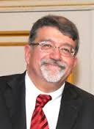
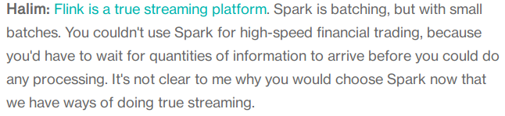
Selecting a candidate
To render IoT4I profitable cost of supporting services and components should be as low as possible.
This establishes ‘Cost’ as selection criterion with the highest priority and we end up with Spark and Flink
Latency and support for complex event processing clearly mark Flink as better choice
Build a prototype now
http://searchcloudapplications.techtarget.com/news/4500277396/Streaming-analytics-the-IBM-way-QA-with-Nagui-Halim
Notes:
Why not streams – costs, not available on all locations (Dallas, London, Sydney) when I started evaluation
Partners look for Open Source and more specifically Flink
IBM Streams: €2.82 EUR/Node hour per tenant instance → 24000 EUR/year

Slide 26
Prototype work

Slide 27
Goals, Scope/Timeline and Team
Goals
The prototype for a shield engine based on Apache Flink should
Prove general feasibility of this approach
Show proper recovery characteristics:
“will the engine recover from an outage and resume work without loss of event or operator information ?”
Gain some experience with sizing Flink and Hadoop with regard to event rate and event complexity.
Get experienced with the operational aspects of Flink on Hadoop like monitoring, upgrade, backup/restore
Serve educational purposes
“learn about Big Data”
Scope
Set up a docker based Hadoop/YARN environment that can be extended to be based on VMs
Set up Flink 1.1.4 for standalone and YARN
Provide a set up some shields to exploit stateful operators & windows
Test for proper recovery (kill processes, kill containers)
Load testing preparation – 4 shields with varying complexity, event rates from 10 to 100 evts/ sec
Out: Fully automated setup
Out: Investigate Apache Calcite as rule editor
Ramp Up
Phase
- Education
- Dev Env
- Test Env
Productive
Phase I
- Create shields
- Test recovery
without load
- Test bed for
load tests
Productive
Phase II
- Test recovery
under load
- Performance
measurements
Collecting
Results
02/21
02/28
03/07
03/08
Team
It’s Thomas, Patrick, Bilal & myself

Slide 28
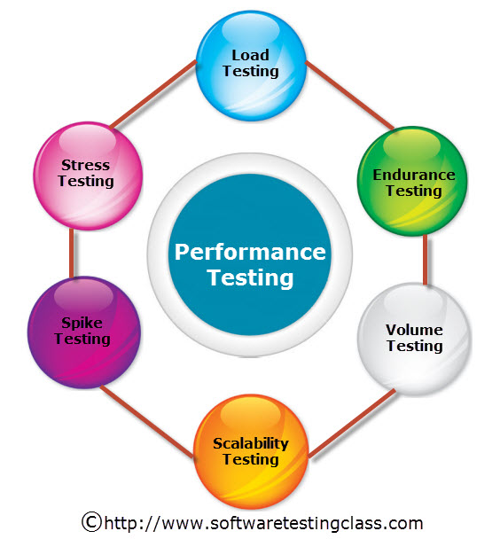
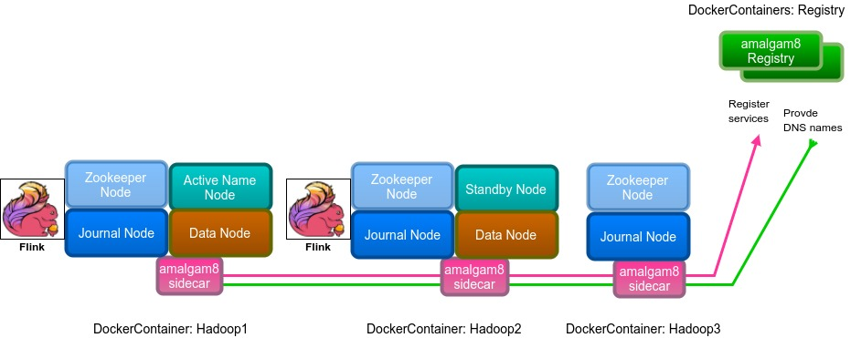
Prototype: Performance Test Setup based on Hadoop on Docker
Note:
This is a minimal setup, equivalent to a ‘lite’ plan on Bluemix
Makes use of volatile local docker storage
Mixes data and compute nodes
Event Generator:
Generates up to 100 evts/ sec
already enriched with ancillary user data,
1000 predefined users )
Action Engine
Test Instance
No MetaData Stream
to activate/deactivate shields
needed for perf tests
Consume and analyze
MQTT topic event stream
Submit Shield Jobs:
One MQTT Consumer Job per Shield !
https://telerikhelper.net/2012/09/21/what-are-performance-testing-and-load-testing/
Notes:
(1) Sensoren im Haus liefern die Daten, werden von Versicherer geliefert
(2) Hausbesitzer registriert sich – entweder per Cloud-to-Cloud oder direkt.
(3) IoT4I gleicht Vertragsnummer etc. ab
(4) und Hausbesitzer delegiert Zugriff auf Cloud-Repräsentation von Sensoren/Gateways an IoT4I (OAuth)
(5) Sensordaten werden mit 3rd party Daten angereichert (weather.com) und auf unerwünschte Abweichungen hin gecheckt
(6) Im Falle einen Problems, sende Alarm zu Kunden und Versicherer.
(7) Wird aus dem Problem ein Schadensfall, leite ‘automatic’ claiming ein.

Slide 29
Final remarks
About the convergence of shields and WIoTP Analytics (RTI)
Basically I see (at least) 3 options
RTI closes the gap with regard to time window support;
then it would be the superior solution based on maturity and a rule GUI
The RTI/Platform teams take over after we finish and offer a solution similar to Azure Stream Analytics
Their experience with Hadoop stack (deployment, operating) is much higher than ours in IoT4I
IoT4I productizes a scalable shield approach based on Flink
Notes:
(1) Sensoren im Haus liefern die Daten, werden von Versicherer geliefert
(2) Hausbesitzer registriert sich – entweder per Cloud-to-Cloud oder direkt.
(3) IoT4I gleicht Vertragsnummer etc. ab
(4) und Hausbesitzer delegiert Zugriff auf Cloud-Repräsentation von Sensoren/Gateways an IoT4I (OAuth)
(5) Sensordaten werden mit 3rd party Daten angereichert (weather.com) und auf unerwünschte Abweichungen hin gecheckt
(6) Im Falle einen Problems, sende Alarm zu Kunden und Versicherer.
(7) Wird aus dem Problem ein Schadensfall, leite ‘automatic’ claiming ein.

Slide 30
THANK YOU!

Slide 31
Top 5 Benefits of IoT to the Financial Services Industry
What we learn from the physical world will transform several industries, including the Insurance Sector in which IoT will have one of the greatest impacts.
¹ First Notice of Loss (FNOL)
Reduced Frequency and Severity of Claims
Superior Customer Experience, Satisfaction and Loyalty
More Accurate Risk Assessment for Underwriting
Automated FNOL Claims Servicing¹
New Product Offerings
Notes:
5 Wege:
Effiziente Risikoanalyse (basierend auf historischen Daten)
Reduzierte “Eintrittshäufigkeit” - basierend auf alerting/vorabwarnung - wetter
Hausautomation leitet automatisch die Schadensmeldung ein
Promotion
Kundenbindung
If your house is burning down, you'll now get Gmail ads for fire extinguishers

Slide 32
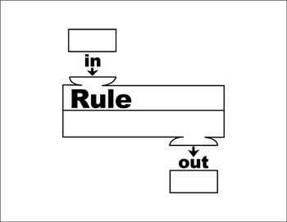


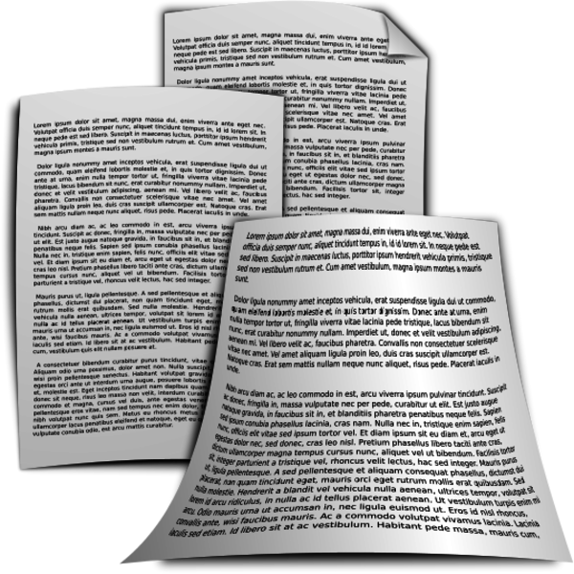




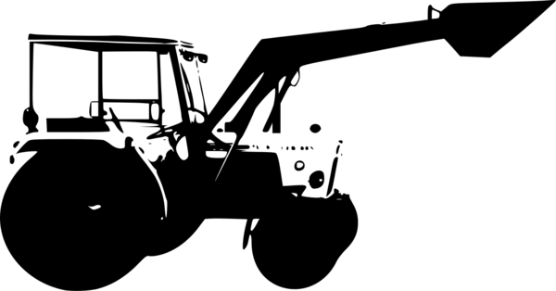
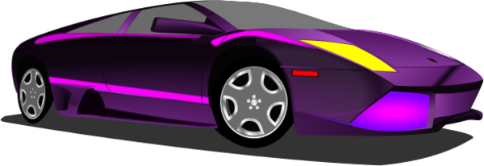
Persistent data in IoT4I – relationships in a single deployment
Activate rule
Device Ownership
Insurance Policy
Policy specific rules
IoT devices
Device Owners
Insurance
holders
Provide rules
Property Ownership
Policy specifies
object of protection
Property determines
specific IoT sensors
Property
Owners
Insurance business owners
Note:
IoT4I doesn’t keep track of device locations yet.
Notes:
(1) Sensoren im Haus liefern die Daten, werden von Versicherer geliefert
(2) Hausbesitzer registriert sich – entweder per Cloud-to-Cloud oder direkt.
(3) IoT4I gleicht Vertragsnummer etc. ab
(4) und Hausbesitzer delegiert Zugriff auf Cloud-Repräsentation von Sensoren/Gateways an IoT4I (OAuth)
(5) Sensordaten werden mit 3rd party Daten angereichert (weather.com) und auf unerwünschte Abweichungen hin gecheckt
(6) Im Falle einen Problems, sende Alarm zu Kunden und Versicherer.
(7) Wird aus dem Problem ein Schadensfall, leite ‘automatic’ claiming ein.

Slide 33
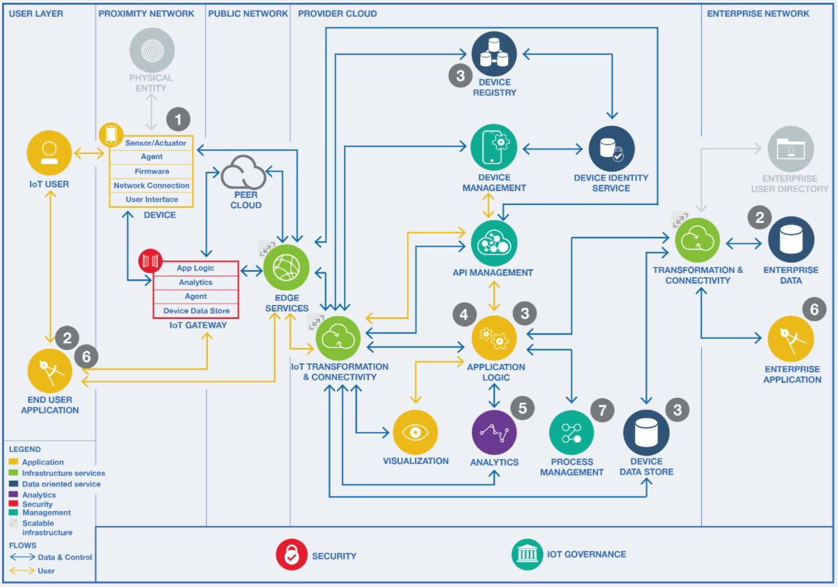
Smart Home Insurance Reference Architecture: Deployment
3rd party (device manufacturer)
IoT platform
IoT platform
Services to connect Customer Data center with Bluemix:
Single sign-on
API Connect
Secure Gateway
IoT4I
IoT4I
https://developer.ibm.com/architecture/gallery/smartHomeInsurance
Notes:
(1) Sensoren im Haus liefern die Daten, werden von Versicherer geliefert
(2) Hausbesitzer registriert sich – entweder per Cloud-to-Cloud oder direkt.
(3) IoT4I gleicht Vertragsnummer etc. ab
(4) und Hausbesitzer delegiert Zugriff auf Cloud-Repräsentation von Sensoren/Gateways an IoT4I (OAuth)
(5) Sensordaten werden mit 3rd party Daten angereichert (weather.com) und auf unerwünschte Abweichungen hin gecheckt
(6) Im Falle einen Problems, sende Alarm zu Kunden und Versicherer.
(7) Wird aus dem Problem ein Schadensfall, leite ‘automatic’ claiming ein.

Slide 34


Slide 35
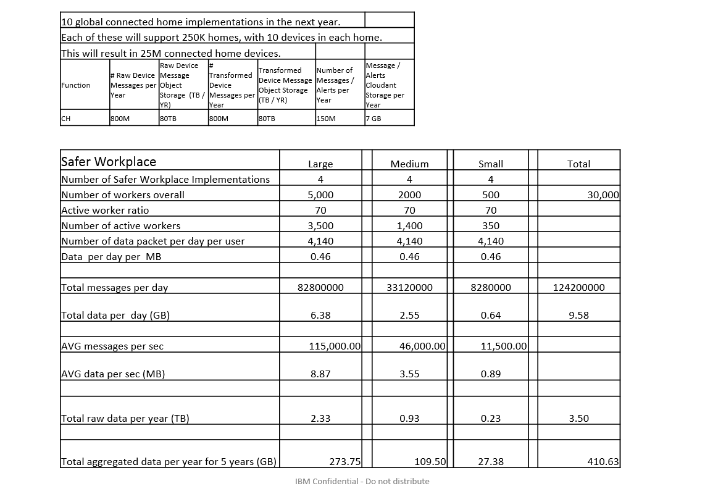
IoT for insurance use case – expected event rates
… blanked out confidential data ...
.. as estimated by Phil and Nir

Slide 36
Stream Analytics frameworks – narrowing down the list of candidates
An overview article* in Predictive Analytics Today mentions five leading frameworks for Stream Analytics
Apache Flink
Apache Spark Streaming
Apache Samza
Apache Storm
IBM Streams (taken as roughly equivalent to Apache Flink, so most of the investigation carries over)
From that list we derived the following approaches
Kafka shield engine – similar to Samza and the more recent Kafka Streams but based on Javascript to allow for the reuse of existing shield code and relying on Bluemix for resource management
OpenWhisk shield dispatcher on Kafka – similar to the “Kafka shield engine” but with OpenWhisk for resource management
Apache Flink with MQTT connector
Apache Spark Streaming on Kafka
And we added the last approach
Agent framework based shield dispatcher on MQTT
was included to open the door for collaboration with our sister project ‘IoT for automotive’
While CEP libraries like WSO2’s Siddhi can work with Storm, it can also be based on Kafka directly, so Storm is only adding complexity; hence I stopped further investigating Storm as viable technology.
*See Imanuel Muller in http://www.predictiveanalyticstoday.com/top-open-source-commercial-stream-analytics-platforms/

